Slide 1
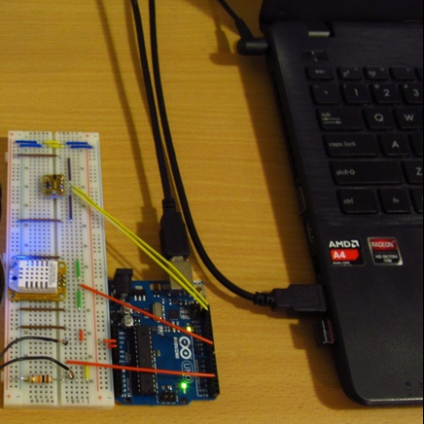
Vehicle Tracking System
via
Google Map and Arduino UNO
Guided by :
Prof. Ratan Kumar Saha
Presented by :
Kalpajyoti Gogoi,CS15MI0399
Kishur Dutta,CS15MI0393

Slide 2
Contents
Introduction
Need of Vehicle Tracking System(VTS)
Literature review
Technology used for VTS
Block diagram of VTS
GPS
GSM
Arduino
Result and discussion
Conclusion
Future work
Referrences

Slide 3
Introduction
Vehicle Tracking System(VTS) is the combination of software and hardware enabling the owner to track the position of their vehicle.
An efficient vehicle tracking system is designed and implemented for tracking the movement of vehicle from any location at any time.
VTS works using Global Positioning System (GPS) and Global System for Mobile communication(GSM) technology that is one of the most common ways for vehicle tracking.
A Smartphone application is also developed for continuously monitoring the vehicle location.
The Google Maps API is used to display the vehicle on the map in the Smartphone application.

Slide 4
Need of Vehicle Tracking System (VTS)
School bus tracking
Theft prevention
Better customer service

Slide 5
Literature review #1
Title : A Review on GSM and GPS Based Vehicle Tracking System
Author : Dinesh Suresh Bhadane, Pritam B.Bharati, Sanjeev A.Shukla, Monali D.Wani, Kishor K.Ambekar
Objective
In this paper a survey is done on various vehicle method of tracking techniques using GSM & GPS. A vehicle tracking system combines the installation of an electronic device which is mounted in a vehicle, or inside of vehicles, with purpose designed computer software to allow the owner or a user to track the vehicle's location, collecting data in the process. Today vehicle tracking systems commonly use Global Positioning System (GPS) technology for locating the vehicle, but other types of automatic vehicle location technology can also be used. Vehicle information can be viewed and located on the electronic google maps via the Internet or specialized software.

Slide 6
Literature review #2
Title : Vhicle tracking system using GPS technology
Author : Kismat Pradhan, Yogesh Limboo, Anu Rai, Avinash Sharma
Objective
Vehicle tracking is one of the most important techniques mostly used in today’s world. A vehicle tracking system works with the installation of a tracking device which is kept inside vehicles, so it allows the user or an owner to track the vehicle’s location. Now a day’s vehicle tracking systems are normally work on Global Positioning System (GPS) technology for tracing the vehicle, but other forms of vehicle tracing technology can also be used. In this paper, a survey is done on various vehicle tracking method using GPS. Vehicle information can be viewed and located on the maps via the Internet or specialized software. In this paper, study is done on a real-time vehicle tracking system that works using GPS and GSM technology, which would be the easiest and inexpensive source of vehicle tracing.

Slide 7
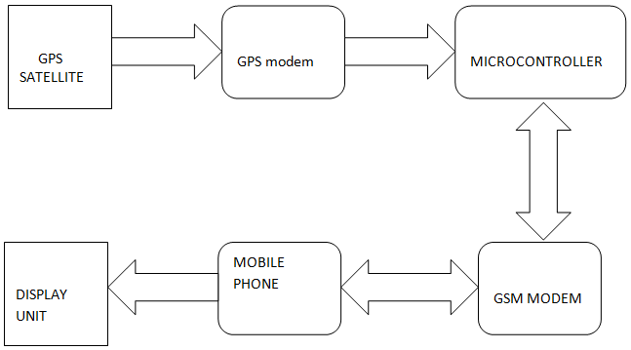
Block diagram of VTS

Slide 8
Technology used for VTS
GPS
GSM
Arduino UNO
Jumper cables
16*2 LCD dislay
C,C++

Slide 9
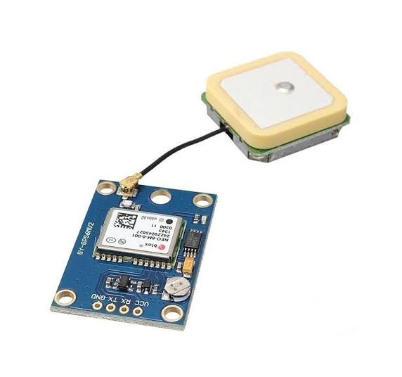
GPS-Global Positioning system
GPS was developed in 1973 by the US Department of defense.
GPS is a space based satellite navigation system provides location and time information in all weather.
Maintained by the United States Government and is freely accessible by anyone with a GPS receiver.
Primary functions of GPS Position and coordinates.
To calculate the distance and direction.
Travel progress reports.
Accurate time measurement.

Slide 10
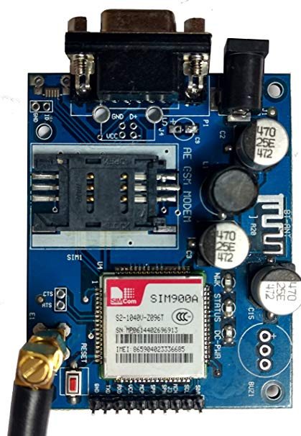
Current locations of GPS Satellites
GPS satellites are orbiting the earth at an altitude of 11,000 miles
GPS receivers store the orbit information for all of the GPS satellites .
GSM-Globle System For Mobile Communication
A GSM modem is a specialised type of modem that accepts a SIM card and operates over a subscription to a mobile operator just like a mobile phone.
It requires in Vehicle Tracking System because GPS can normally only receive location from satellites but can’t communicate back with them.

Slide 11
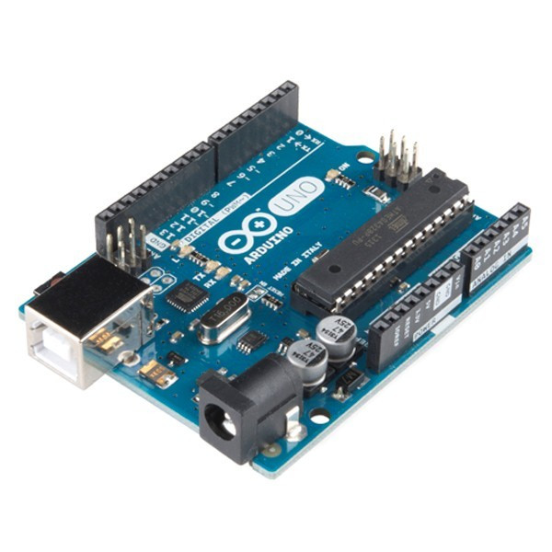
Arduino UNO
Arduino is an open-source electronics microcontroller platform based on easy-to-use hardware and software. Arduino boards are able to read inputs - light on a sensor, a finger on a button, or a Twitter message - and turn it into an output - activating a motor, turning on an LED, publishing something online.
You can tell your board what to do by sending a set of instructions to the microcontroller on the board. To do so you use the Arduino programming language(based on Wiring), and the Arduino Software (IDE), based on Processing.

Slide 12
Advantages of Arduino
Open source
Simplified and user friendly programming language
Portable
Lower power consumption
The basic Arduino board

Slide 13
Result and discussion :

Slide 14
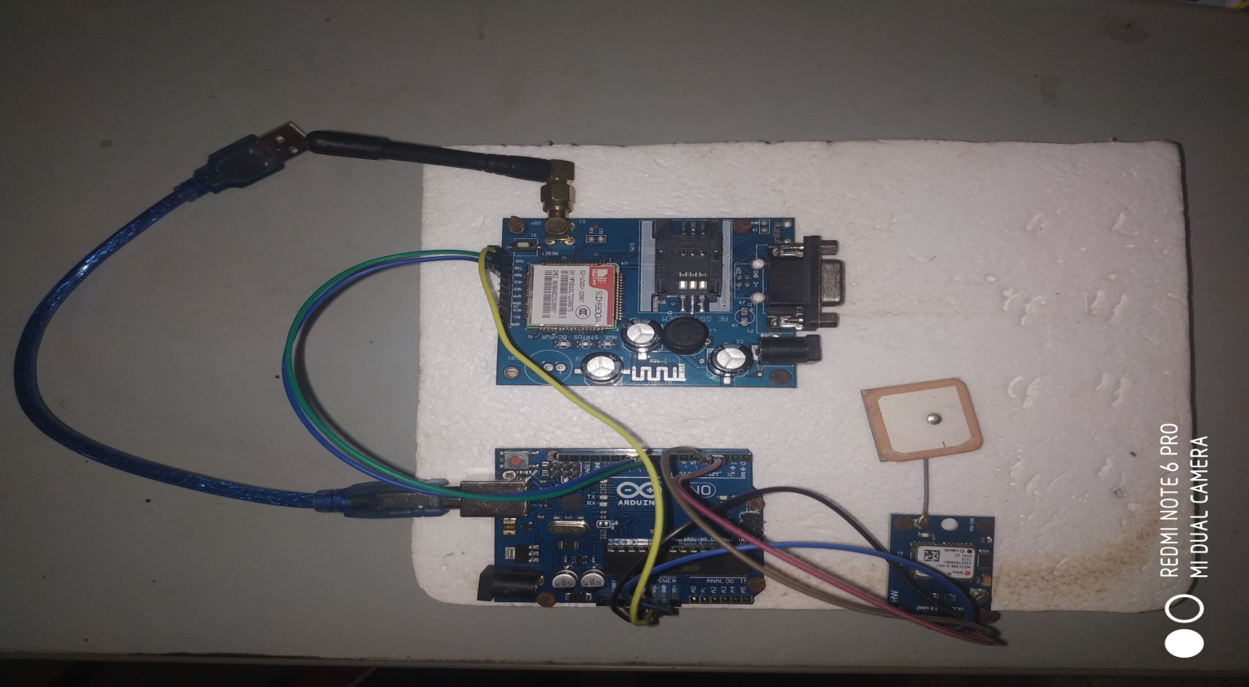
Screenshots :
The whole circuit without power connection

Slide 15
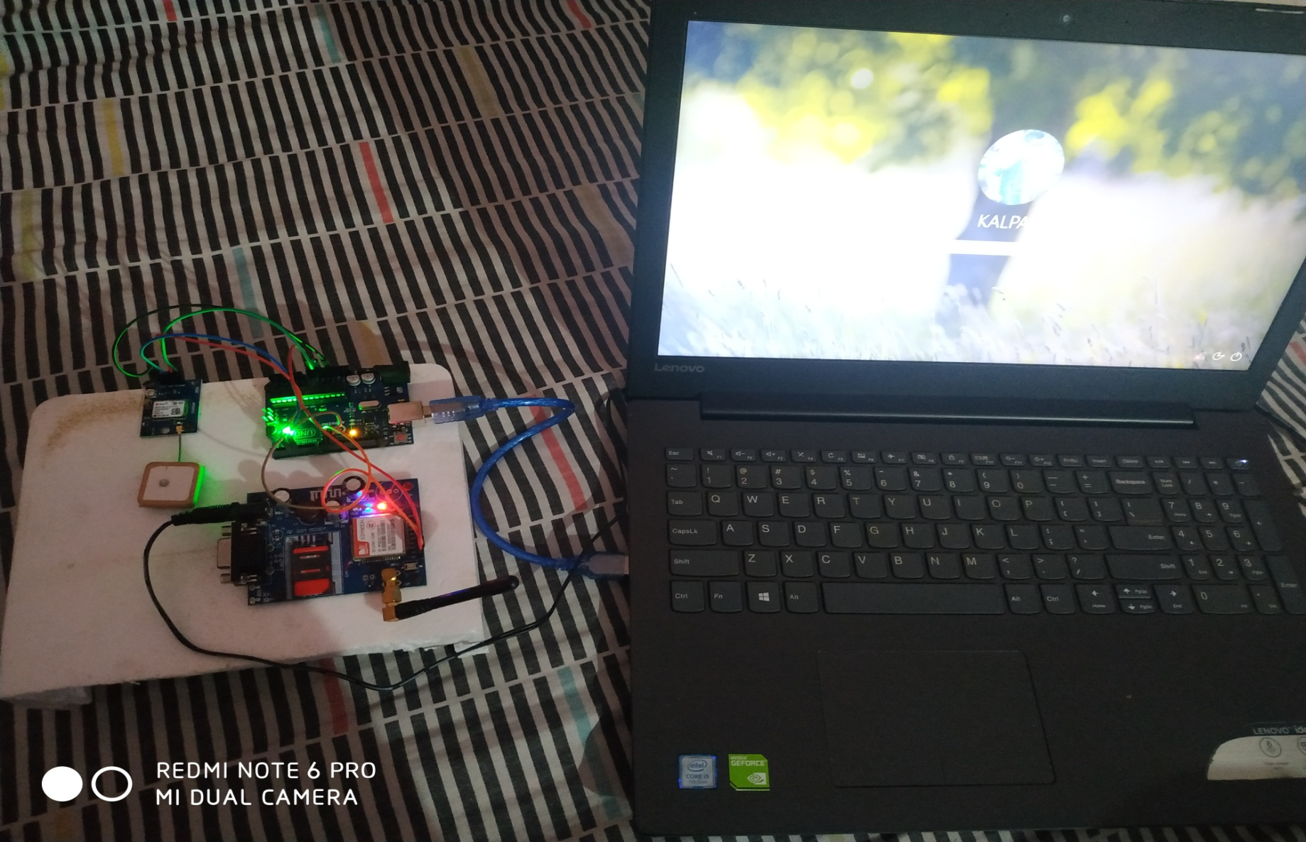
Circuit after getting power supply through USB cable

Slide 16
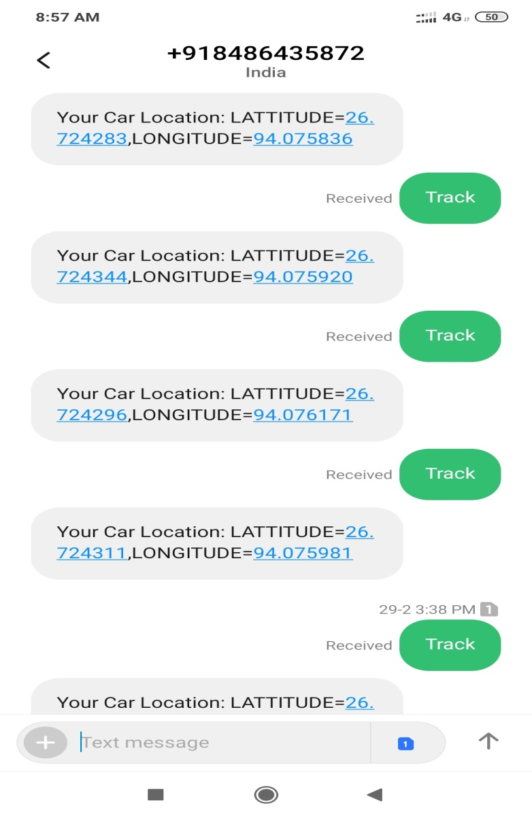
Output display on handset

Slide 17
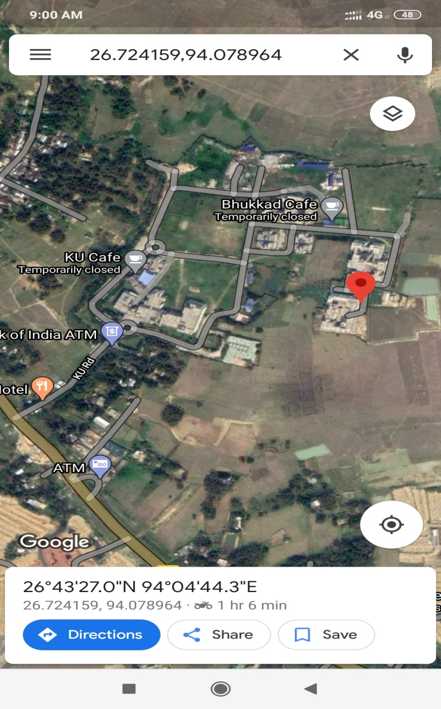
Display of the map on handset to indicate the location

Slide 18
Conclusion :
Vehicle tracking system makes reduce the risk of theft of vehicles, better fleet management, better control of traffic, and which in turn brings large profits. Better scheduling or route planning can enable to handle large no. of jobs loads within a particular time. Vehicle tracking can be used by individual as well as organization to improve safety and security, communication medium, performance monitoring and increases productivity. So in the coming year, it is going to play a major role in our day-to-day living.

Slide 19
Future work :
An alarm system to be implemented inside the vehicle along with existing Vehicle Tracking System (VTS).This alarm will be activated if someone try to destroy VTS of the vehicle and alarm will send a notification to the owner. So that the owner can take some immediate action.
We will try to convert the latitude and longtitude value into an URL link.

Slide 20
Referrences
Web references :
www.wikipedia.com
www.electronics4u.com

Slide 21


